Slide 1
CRYPTOGRAPHY AND NETWORK SECURITY
RC4

Slide 2
Introduction to Stream Cipher
Encryption that converts one byte plaintext to cipher text at a time.
Why one byte?

Slide 3
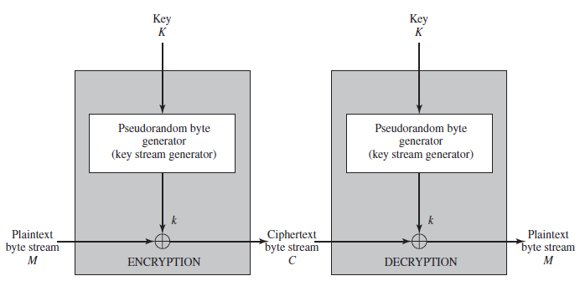
Working of Stream Cipher

Slide 4


Working of Stream Cipher
Encryption:
Decryption:

Slide 5
Important Consideration in Designing of Stream Cipher
1.
Encryption sequence should have large period.
2.
Keystream produced by PRNG should approximate the properties of a true random number as close as possible.
3.
Output of PRNG depends upon the key, which should be sufficiently large to guard against brute force attack.

Slide 6
RC4
Stream cipher designed by Ron Rivest in 1987.
RC4 is
Variable key size
stream-cipher
Byte oriented operation
Period of the cipher is greater than 10¹⁰⁰ .

Slide 7
Steps in RC4
Variable length key of form 1 to 256 byte (8 to 2048 bits) is used to initialize a state vector S.
S has elements S[0],S[1],….S[255] which contains all possible permutation of 8 binary bits from 0 to 255.
For encryption and decryption, a byte is generated from S by selecting one of the 255 entries in a systematic fashion. As each value of is generated, the entries in S are once again permuted.

Slide 8

Initialization of S
The entries of S are set equal to the values from 0 through 255 in ascending order . S[0],S[1],…,S[255].
A temporary vector, T, is also created. If the length of the key K is 256 bytes, then is transferred to T.
Else for a key of length keylen bytes, the first keylen elements of T are copied from K, and then K is repeated as many times as necessary to fill out T.

Slide 9

Initialization of S (cont…)
T is used to produce the initial permutation of S. This involves starting With S[0] and going through to S[255] , and for each S[i] , swapping S[i] with another byte in S according to a scheme dictated by T[i].

Slide 10


Stream Generation
Stream generation involves cycling through all the elements of S[i], and for each S[i] , swapping S[i] with another byte in S according to a scheme dictated by the current configuration of S. After S[255] is reached, the process continues, starting over again at S[0]

Slide 11
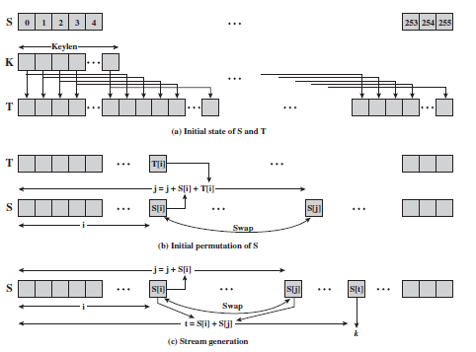
Strength of RC4

Slide 12
References
W. Stallings, ”Pseudorandom Number Generation and Stream Cipher,” in Cryptography and Network Security Principles and Practices, 5th edition Prentice Hall, 2006, pp. 232-236.

